Slide 1
Code Quality & Security (CQS) Workstream Update PI-12 PI Feedback Session – 27 January 2021 Presenters Godfrey Kutumela Lewis Daly Victor Akidiva Aime Bukasa Support Members : Kim Walters, Pedro Barreto, Miguel de Barros, Sam Kummary & Tom Daly

Slide 2
About Code Quality & Security Workstream
Objective:
Continuously improve the Trust (reliability, transparency, privacy, compliance, quality and security) of the Mojaloop Platform and transform our approach to quality and security in line with L1P principle on data privacy and emerging technological trends.
Delivery Model:
Supports both functional and non-functional requirements of the project, working alongside with other workstreams & various governance committees on a shared responsibility Model.
Approach:
Standards and Control Centric – Define and maintain Mojaloop software quality and security standards and guidelines – In certain areas we provide reference implementation whereas for other areas we require certain policies or standards to be adhered to.
Risk and Threat Centric – Perform risk assessments and threat modelling to identify, validate, classify & prioritize security requirements.
Milestones:
PI 1 – 8 : Foundation Phase - Built-in confidentiality and Integrity as part of the Core Mojaloop Architecture.
Developed and Implemented Signatures, MTLS, PKI, encryption standards
Established a code quality and security framework - DevOps & CI/CD Tools automation, workflows & policies
PI 9 – Current: Phase 5 (One Loop for all) – Consolidate, optimize & improve.
Introduced a risk and threat driven approach
Baselining Mojaloop against best practice standards – PCI DSS and GDPR
Focus on the data protection, Cryptographic Controls (CPM and FIDO) and Deeper Community Engagement
Notes:
We must archive all these while keeping governance lightweight and balancing between developer usability and policy. 2 of L1 principles filters down our stream – Data privacy and ensure governance is as lightweight as possible to encourage community volunteers to contribute freely and easily.
The overarching aim is to prescribe the use of certain quality/security practices and techniques delivered as guidelines and in some areas, we have reference technology implementations whereas for other areas we require certain policies or standards to be adhered to and verifiable.

Slide 3
PI 12 Objectives
PI 11 objectives breakdown per epic
CQS Epic | Epic Objective (Multi-PI) | PI 12 Objective
1. Functionality Support | Enhance security in new functionality additions | Support FRM and PIPS – Threat Modelling & Design Reviews
2. Implementation Support | Advisory support to all implementations | Mowali Support - GDPR Compliance and AML Requirements
3. Identity & Access Mgmt. | Improve IAM measures and controls | Finalize CPM Designs and explore Passwordless - FIDO
4. Data Protection | Improve data protection measures and controls | Establish Data Protection Standards
5. Standards Baselining | Baselining of Mojaloop against best practice standards | Baseline against ISO 27001 and NIST – Deferred to PI 13
6. DevSecOps | Maintain and enhance secure DevOps/CI CD practices | Ongoing maintenance & enhancements – licensing, Patching
7. Community Engagement | Improve communication and community engagement | Implement the new CQS documentation structure
How these Epics and PI objectives are decided
Product Enhancements
New functionality additions
Alignments with best practice standards
Controls gap analysis and improvements
Threat and Risk Centric Approach
Threat modelling and risk assessments
Open Consultations
Requests from implementors and the community
Notes:
Gap analysis by the CSQ core team
Standard baselines
Risk and threat assessments
New functionality additions

Slide 4
PI 12 Achievements
Functionality Support
IAM & Data Protection
DevSecOps
Community Engagement
Implementation Support
PISP
Threat modelling – Mobile App
Secure OTP
FIDO
PKI implementation
FRM
DevSecOps alignment on tool, policies and processes
Design security reviews – In Progress
Data privacy, data protection and access control – PI 13
Data Protection
CQS LAB environment for testing recommended secure configuration
Investigate EFK logging for security monitoring
Developed a database security standard
Exploring ZKP to reduce PII datasets in the switch
IAM
Complete CPM Low level designs
Develop a FIDO architecture model for Mojaloop implementers
Operational
On going support and maintenance activities
Regular security patches + updates
Addressing regular Dependabot alerts,
Running `npm audit` on flagged repos
Enhancements
Audited and streamlined GitHub repo access – Created new Org - Mojaloop admin
Applied updated license across Mojaloop Org
Communication
Implemented the new CQS documentation structure as per below 3 sections
Program management
Standards and Guidelines
Reference implementation
Community Input and Concerns
Default network configuration of our K8 objects – Cluster, POD and Nodes
GDPR Compliance
PII Access Management – Just in time access
Data retention strategy
GDPR policies and procedures.
Security architecture improvement plan
AML Requirements
Review high-level requirements
Provided implementation options and approaches
More support actives planned for PI 13
https://github.com/mojaloop/project#workspaces/mojaloop-project-59edee71d1407922110cf083/board?epics=116650553_1778&filterLogic=any&repos=116650553

Slide 5
DevSecOps and CQS Documentation Presenter Lewis Daly

Slide 6
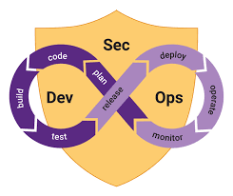
DevSecOps
PI objective – On going maintenance and enhancements of the DevSecOps processes, policies and tools and policies.
On going support:
Regular Security Patches + Updates
Addressing regular Dependabot alerts
Running `npm audit` on flagged repos
Fixing broken builds
GitHub Updates:
Archived ~24 old repos
Improved code check in security steps
Removed individuals from repo ownership, removed unneeded admin access to repos
Added code owners to “core” repos
Require all CI/CD steps to pass
Updated master branch protection rules
Updated License file across all repos
Notes:
Lewis

Slide 7
New CQS Documentation Overview
The documentation is segmented into 3 areas below for ease of read and update:
Program management - Provide an overview of Mojaloop’s risk and security management initiatives at program level. The target audience is risk management, compliance, governance, regulatory and leadership (business/government) stakeholders.
Standards and guidelines – Provide recommended security measures and controls to be considered for implementation by the switch core team and or hub operators. The target audience is architects, implementation engineers, security management and IT Ops.
Reference implementations – There are standard, and guidelines as applied on the Mojaloop standard API. The target audience is architects, DevOps teams, security engineering, QA teams and Developers.
Quick Demo
Notes:
A lot has

Slide 8
PISP Functionality Support and Data Protection Epics Update Presenter Victor Akidiva Aime Bukasa

Slide 9

PISP Support (PISP Mobile app security)
PI objective – Review design of PISP mobile application security for Android and IOS devices.
Tasks:
Detailed review of Android and IOS KeyStore security
Analysed FIDO their key storage techniques
Key focus areas were
Device Security | Application Security | Data Security | Network Security
Key findings:
IOS and Android (version 7+) are FIDO level 2 certified - Approx.
78% of all android devices run version 7+ (statistica source)
The devices stand in as security keys themselves when users authenticate.
A FIDO server is required to authenticate any FIDO registration or authentication requests – New FIDO Architecture addresses this.
For devices without a fingerprint sensor, Android will allow you to use other methods, like a PIN or swipe pattern
A setup required to enable the phone’s FIDO security key – possible operational overheads i.e., user education, lost device etc.
To us, FIDO2 provides a simple user experiences backed by strong cryptographic security that is transparent to the user and protects against phishing, man-in-the-middle and attacks using stolen credentials
Notes:
Android
.
Stories - IOS Devices and Android Devices
Completed:
Detailed review of Android keystore security
Detailed review of IOS Keystore security
Analysed FIDO key storage using Android and IOS keystore for possible threat modes and recommendations
Key focus areas were:
Device Security | Application Security | Data Security | Network Security
Key findings:
IOS and Android (version 7+) are FIDO level 2 certified.
Approx 78% of all android devices run version 7+ (statistica source)
The devices stand in as security keys themselves when users authenticate. This allows users to authenticate with biometrics instead of relying on a separate security key.
A FIDO server is required to authenticate any FIDO registration or authentication requests. We need to identify where this will sit in overall architecture.
For devices without a fingerprint sensor, Android will allow you to use other methods, like a PIN or swipe pattern that you use to unlock your phone, to authenticate.
There is a setup required to enable the phone’s FIDO security key. This may have operational overheads i.e. user education, lost device etc.

Slide 10
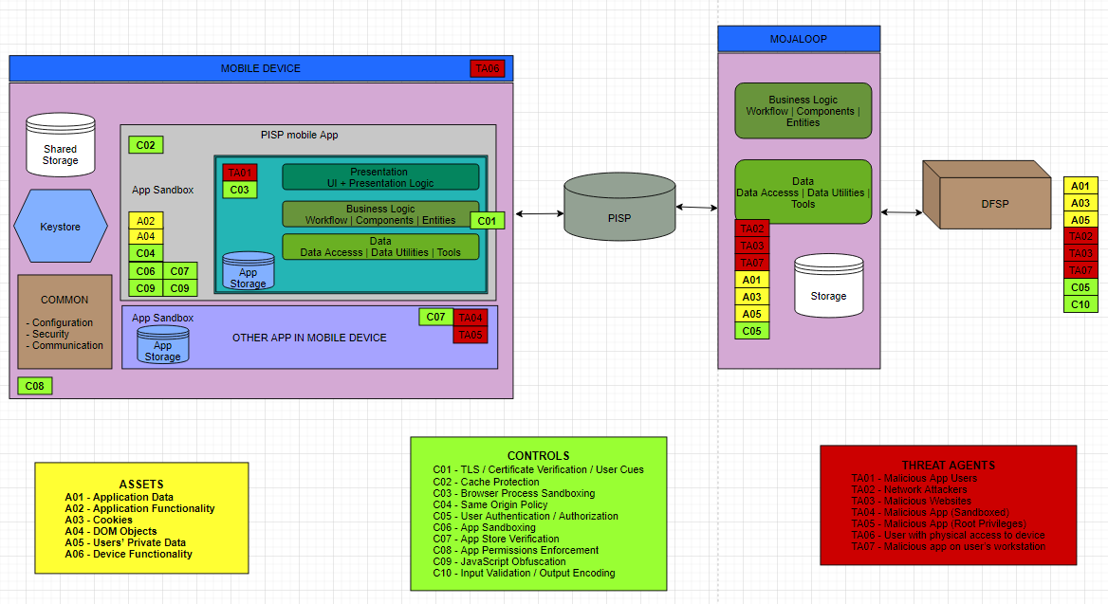
PISP Mobile App - Threat Modelling
Notes:
STRIDE Model for PISP Mobile App
This is not the sequence flow.
Reference flow as per PISP document flow

Slide 11
PISP App Security Enhancements (IOS / Android)
Below are recommended additional security measures:
Ensure IOS and Android code is reviewed to ensure no information disclosure risk. Its possible to embed malicious code within the developed app that may allow a rogue coder issue instruction to the PISP mobile application.
Store passwords plus some additional user information using salted hash values in the KeyChain as opposed to storing just the password values alone.
Enforce credential validation after user has signed in to ensure that user unlocked their device themselves using UserDefaults variable in IOS. This checks that the current user exists in the system which is initialized on login
Configure login notification for successful / failed authentications as well as transaction notifications / credential changes.
Restrict access to jailbroken devices that may allow third party tools with malicious intent to execute within user phone.
Notes:
Salted Hash Password - An attacker who compromises the Keychain would find this hash. The attacker might create a table of commonly used passwords and their hashes to compare against this hash. If you hashed just the user’s input without salting, and the password existed in the attackers hash table, the password would be compromised.
Additional recommendations for IOS:
Keychain services offers ways to manage the accessibility of individual keychain items according the state of the device, combined with inputs from the user. This is done by by setting the item’s kSecAttrAccessible attribute when you create the item. Our recommendation is enforcing biometric authentication for all keychain access for PISP. This is done using .privateKeyUsage and .biometryCurrentSet are the authentication settings for keys. To use the keychain item, a user must provide biometric authentication. Other authentication attributes are possible depending on the version of the IOS device and its capabilities.
Create Access Control for the key, kSecAttrAccessibleWhenUnlockedThisDeviceOnly is the accessibility settings for the keys. That means applications can only access the keychain item when specific device has been unlocked.
Code security - Ensure the function SecIdentityCopyCertificate and SecIdentityCopyPrivateKey are not part of compiled PISP code as it can extract the private key by retrieving a certificate associated with an identity as well as the private key associated with an identity within the KeyStore.

Slide 12

Data at rest security review
PI objective – Review Mojaloop data at rest and recommend data protection standard guided by best practices (GDPR, PCIDSS etc).
Stories - Data at Rest standard
Tasks:
Review all Mojaloop datastores containing data at rest
Identify datastores containing sensitive PII data
Conduct STRIDE threat model review of Mojaloop datastores to establish high risk areas (data breach)
Identify recommendations to protect data at rest
Document database audit logging standard and security monitoring use cases
Key findings:
Mojaloop data at rest include information from the following sources:
Application logs
System and infrastructure configuration files
System logs
Databases
PII data is contained in Mojaloop datastores e.g. MSISDN, Names, Email etc
Communication between Mojaloop internal services via Kafka is not encrypted

Slide 13
Database Security Standard – Key Highlights
Below is highlight of some of issues addressed by our proposed database security standard
Enforce access control restrictions on Mojaloop databases - Ensure passwords are not stored in global configuration files and ensure local authentication bypass is not enabled for any database instance
Enable TLS encryption on connections to / from the database. Guided by risks and if technically feasible, encrypt PII datasets. This may impact performance and bring forth operation support challenges, but it is highly advised.
Perform database hardening as per CIS standards and Install relevant patches for the databases as per change management procedure.
Enable audit logging for all CRUD actions on sensitive data and where applicable ship logs to a SIEM for monitoring and Configure appropriate file system permissions for critical database files
Review database code submitted by developers for any malicious code. Ensure developers are familiar with SQL injection prevention guidelines. Disable server-side scripting where feasible.
13
Notes:
database hardening activities:
Perform database hardening activities.
.
Configure appropriate file system permissions for critical database files
Ensure passwords are not stored in global configuration files
Ensure local authentication bypass is not enabled for any database instance
Disable server side scripting
Install relevant patches for the databases as per change management procedures
Additional Activities
Conduct a data classification exercise to identify types of data at rest within Mojaloop, where they are stored and access controls for each data type.
Configure replication and auto failover recovery options in the event of database failure. These should be supported by relevant backups to maintain point in time data.
TLS - Harness supporting databases’ publisher/subscriber (Pub/Sub) or Message Broker ability that can help in building the foundation of microservices architecture. It helps in decoupling the services and makes their communication more effective. Redis supports this design.
<<REDUCE WORDING>>

Slide 14
Focus on Security Testing – Planned scope for PI 13+
Requirement | Description | Purpose
Docker and Kubernetes | Scan all containers continuously for Vulnerabilities using Anchore-CLI | - Fine tune Anchore-cli policies - Test remediation efforts on updated containers - Test audit logging policies around Kubernetes - Test security policies around running containers
EFK and Logging | Have EFK fully configured and working | - Test security logging and also develop security dashboards (basic) - identify minimum logs to be captured and monitored in a mojaloop engironment - Explore capacity issues related to logging (security)
Kafka | Access to Kafka logs | - Test audit logging policy - test data protection recommendations (data in motion) - Export audit logs to EFK
Database | Enabled database logs for critical databases | - Capture logs in EFK - Create dashboards on database activity
Operating System | Enabled audit logging to /var/log/audit/audit.log | - Ship audit logs in EFK using auditbeat - Create basic dashboards on user activity
WSO2 | Enable audit logging and explore features around WSO2 IAM that will be useful to Mojaloop | - Review WSO2 audit logs - Push API logs to EFK? - Push user activities to EFK for centralised monitoring - API Gateway logs to EFK - Test IAM policies e.g. federation
Infrastructure | Capture critical infrastructure logs to EFK | - These include firewalls, HAProxy to log all successfyl/unsuccessful authentications - Capture MTLS authentication - Establish logging capacity issues - Auto inventory of all running components to help track issues around patch and vulnerability management - Conduct targetted attacks (Penetration Testing)
Golden path testing ability | Execute simulated transactions | Test data protection issues for data in transit / storage Identify PII data Test for breaking changes due to new security configs
Notes:
Focus on Requirement section.
Leave out Purpose due to time.

Slide 15
Identity and Access Management (Towards a Passwordless Mojaloop) Presenter Aime Bukasa

Slide 16
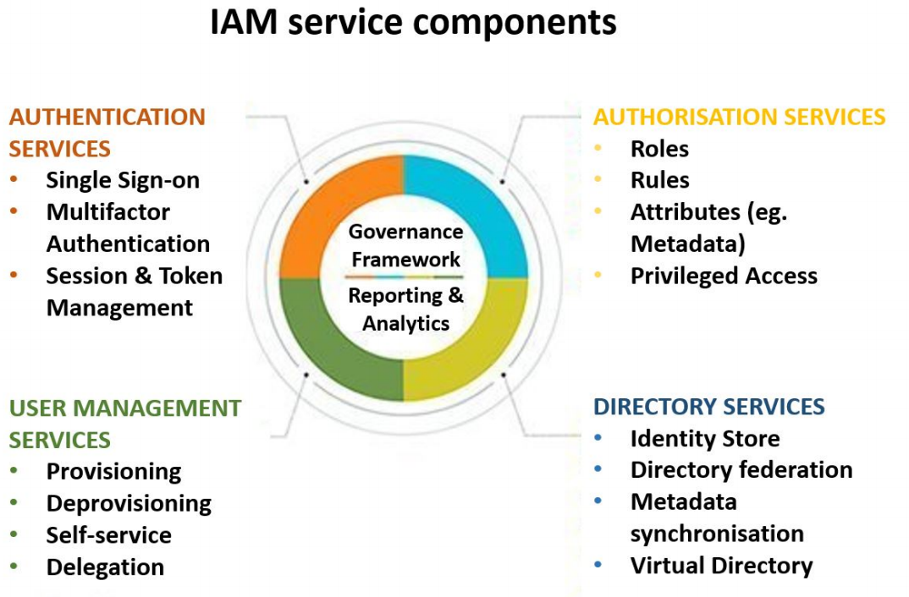
Identity & Access Management Reference Framework

Slide 17
Why Passwordless Authentication
81% of successful cyberattacks are due a compromised password or username as per Verizon Data Breach Report - 2018

Slide 18
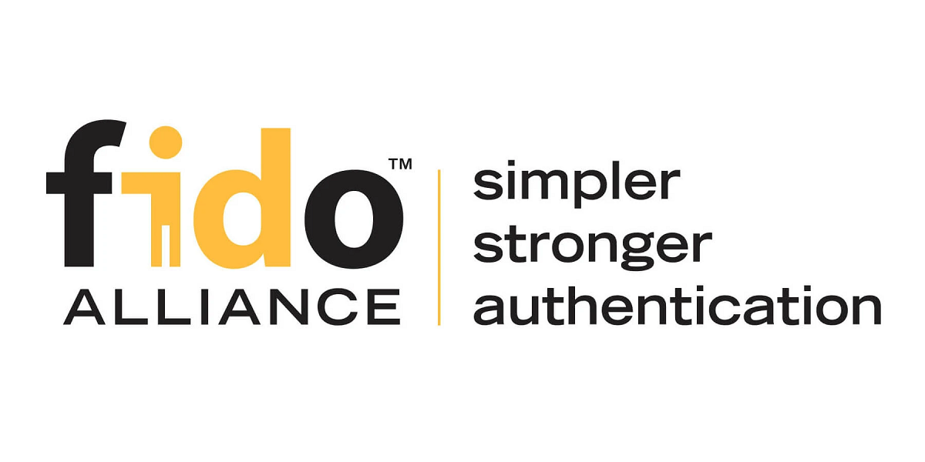
FIDO – Specification Overview
The FIDO Alliance has published three sets of specifications for simpler, stronger authentication:
FIDO Universal Second Factor (FIDO U2F),
FIDO Universal Authentication Framework (FIDO UAF)
and the Client to Authenticator Protocols (CTAP).
Client To Authenticator Protocol CTAP is complementary to the W3C’s Web Authentication (WebAuthn) specification; together, they are known as FIDO2.
All FIDO protocols are based on Public Key Cryptography (Elliptic Curve Cryptography) and are strongly resistant to phishing.
Supported by Google & Yubico (Co-Creators of FIDO U2F), Microsoft, Amazon, Intel, Thales, Facebook, Dropbox, GitHub, Salesforce.com
Notes:
5 min.
Support
Support for FIDO

Slide 19
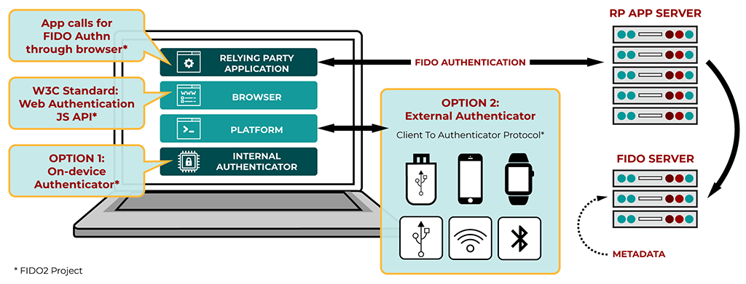
Overview of FIDO 2 Standard

Slide 20
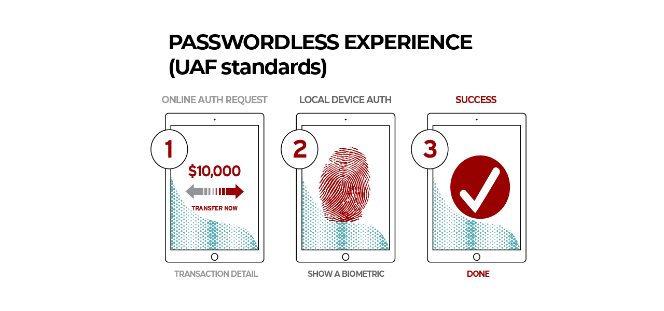
FIDO Universal Authentication Framework (UAF)
Hackers loves passwords, they’re hard for humans to remember and easy for hackers to guess!!
Notes:
Designed so we can implement as functions become available
Enables us to do concurrent development
Break use cases down into functions
Identify regional preferences for HSMs
Confirm that each identified HSM can perform the functions identified
If not, engage with each HSM provider to see if this can be done
Full transaction flow
Define inter-module message API, including Mojaloop to CPM

Slide 21
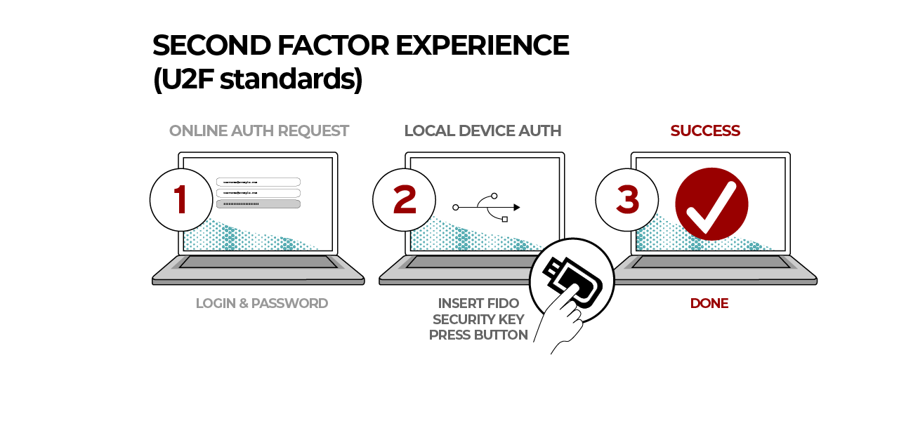
FIDO Universal Second Factor Authentication(U2F)
Microsoft records 85 million Azure Logging every month, using windows hello or Microsoft authenticator – This is back by a FIDO based implementation in Azure Active Directory
Notes:
U2F advantages
Strong security — Strong two-factor authentication using public key crypto that protects against phishing, session hijacking, man-in-the-middle, and malware attacks.
Easy to use — Works out-of-the-box thanks to native support in platforms and browsers including Chrome, Opera, and Mozilla, enabling instant authentication to any number of services. No codes to type or drivers to install.
High privacy — Allows users to choose, own, and control their online identity. Each user can also opt to have multiple identities, including anonymous, with no personal information associated with the identity. A U2F Security Key generates a new pair of keys for every service, and only the service stores the public key. With this approach, no secrets are shared between service providers, and an affordable U2F Security Key can support any number of services.
Multiple choices — Open standards provide flexibility and product choice. Designed for existing phones and computers, for many authentication modalities, and with different communication methods (USB and NFC).
Cost-efficient — Users can choose from a range of affordable devices online. Yubico offers free and open source server software for back-end integration through the Yubico Developer Program.
Electronic identity — Identity proofing is offered for organizations requiring a higher level of identity assurance. Through service providers it is possible to bind your U2F Security Key to your real government issued identity.

Slide 22
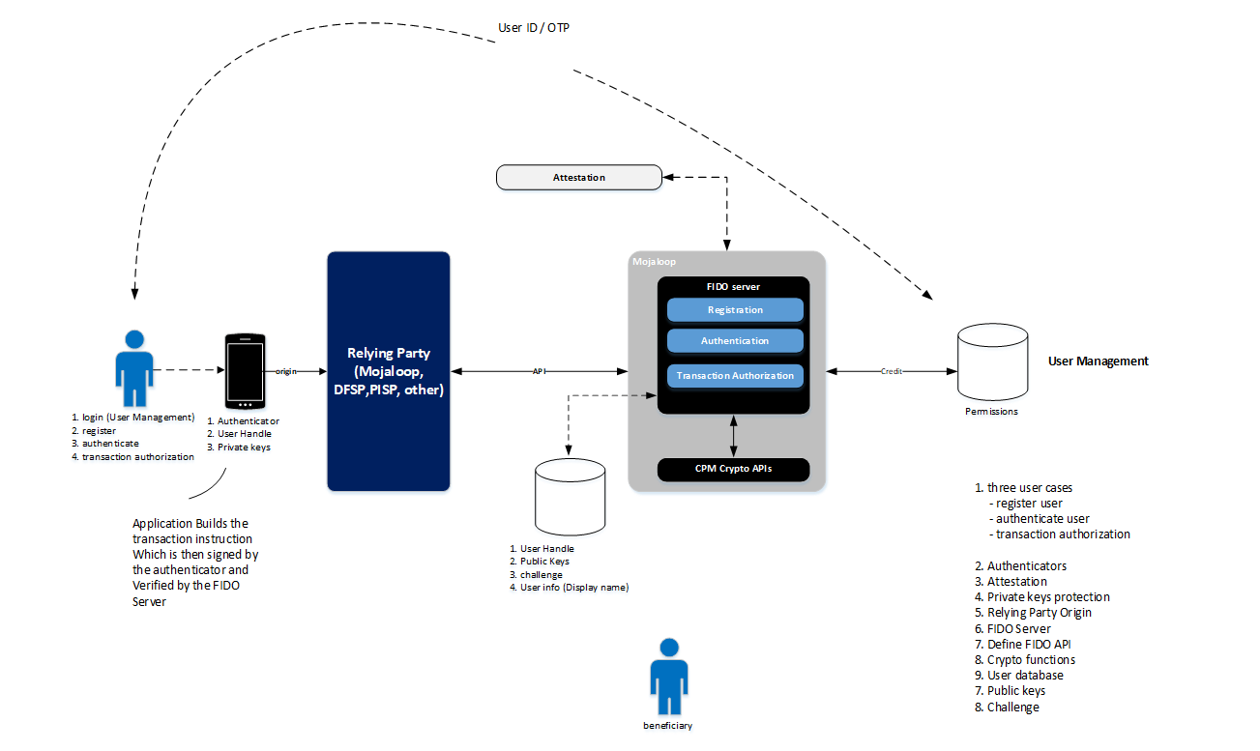
Mojaloop FIDO Architecture Framework
Notes:
Take out Mojaloop,
PISP, FRM (From Risk Management) and other

Slide 23
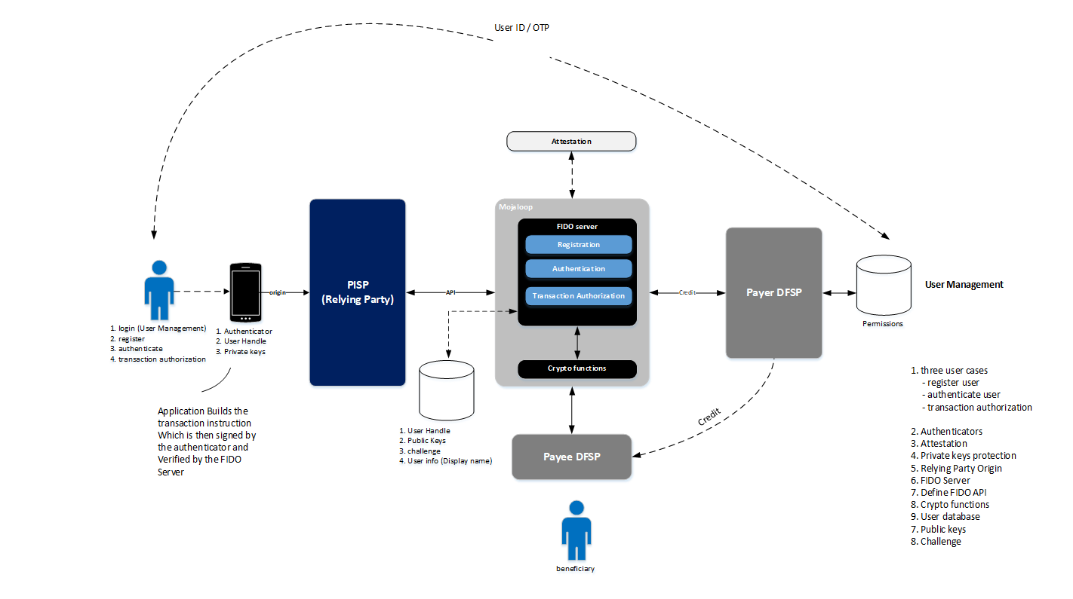
PISP FIDO Use Case

Slide 24
IAM Epic Gap Analysis – Scope for P1 13+
Identity Management
Authentication
Authorization
Credential Management
Self Service
Profile Management
User registration
IAM Workflow
User Provisioning
Application Integration
Anonymization and Pseudonymisation
Authentication factors
Authentication servers
SAML 2.0
Oauth 2.0
FIDO
Federation IAM systems
Access Control
Rule-based authorization systems
Role-based authorization control
IAM and Access Policies
Delegated Administration
Reconciliation
Monitoring
Addressable scope activities include:
CPM Build Phase
FIDO High-Level Architecture and decide on more FIDO Implementation Use Cases
Threat Modelling and Risk Assessments
Alignment and Baselining against standard best practices
Current IAM Control improvements ( e.g. WS02 Federation Policies)

Slide 25
PI 13+ Roadmap Items
Functionality Support
IAM and Data Protection
DevSecOps
CQS Lab Testing
Implementation Support
Demo\Hackathon Lab
CIS benchmark hardening – OS, DB’s, K8 and Network
Perform standard baselines for NIST and ISO2700
FRM
Design security reviews – In progress
Select data privacy, data protection and access control measures
PISP
Implement PI 12 recommendations
Data Protection
Investigate EFK SIEM capabilities for central logging and security reporting
DB vulnerability, activity monitoring & access auditing – Tools and process
Develop K8 security standard
IAM
Implement CPM designs
Scope priority use cases and LDD for FIDO Architecture
POC FIDO
Agile through IAM Gaps
Operational
Regular security patches + updates
Addressing regular Dependabot alerts,
Running `npm audit` on flagged repos
Improvements
Automated releases asap (for at least the core packages),
Operationalize ml-operator for new releases alerting
Review existing CI/CD scanning policies
Test custom security configuration:
Kafka security standard
Logging standards configuration
K8 security standard
Test identity federation configurations on WSO2 to allow PISPs and DFSPs manage their users and maintain least privilege security.
Create Security Dashboards for:
Database activities
User activities
Patch alerts
Push API log to EFK
GDPR Compliance
Tackle the unstructured datasets
Security Operations
Vulnerability Management support
Implement ml-operator for release alerting
AML Requirements
Solution workshop – designs, implementation plan and approach
Define OSS support scope

Slide 26
Thank you Questions and Comments
muchas gracias

